Slide 1


Air Jordan Airlines: A Vision for the Future of Aviation
Presenter: Solomon Feleke

Slide 2

Section 1
The Innovative Approach to Air Travel

Slide 3


Revolutionizing Customer Experience in Aviation
Seamless Digital Integration
Air Jordan Airlines enhances customer experience through a fully integrated digital platform, enabling effortless flight bookings, real-time updates, and personalized travel itineraries, ensuring passengers feel informed and valued throughout their journey.

Slide 4

State-of-the-Art Fleet for Maximum Comfort
Passenger-Centric Design
Aircraft interiors prioritize spaciousness and comfort, enhancing the overall flying experience for travelers.
Advanced In-Flight Amenities
Features like individual entertainment systems and gourmet dining options elevate passenger satisfaction during flights.
Commitment to Sustainability
Fleet modernization includes eco-friendly technologies, reducing environmental impact while maintaining high comfort standards.

Slide 5


Exceptional In-Flight Services and Amenities
Tailored Passenger Experiences
Enhanced Comfort Features
Air Jordan Airlines prioritizes personalized service, offering tailored amenities such as customizable meal options and dedicated assistance, ensuring each passenger's unique preferences are met during their journey.
The airline incorporates advanced comfort features, including adjustable lighting, noise-canceling headphones, and temperature control, creating a serene environment that promotes relaxation and enjoyment throughout the flight.

Slide 6






Commitment to Safety and Operational Excellence
Employee Empowerment
Proactive Safety Management
Integrated Safety Technologies
Encouraging staff to report safety concerns fosters a transparent culture, leading to timely improvements and a stronger commitment to safety practices.
Continuous monitoring and assessment of safety protocols ensure compliance with evolving regulations, enhancing overall operational safety and reliability.
Utilizing advanced analytics and real-time monitoring systems allows for predictive maintenance and swift responses to potential safety issues, ensuring passenger security.

Slide 7
Section 2
The Future of Air Jordan Airlines

Slide 8
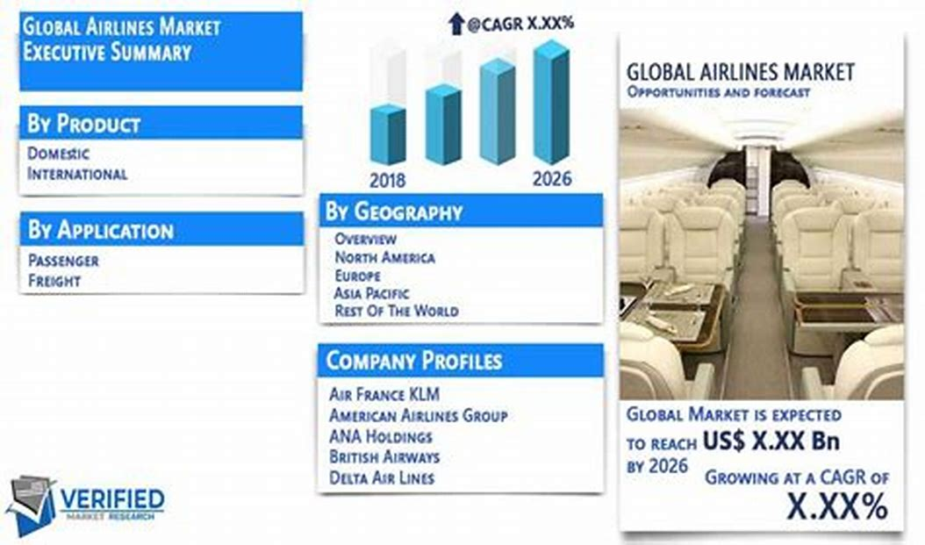


Expansion Plans and New Destinations
Targeted Market Analysis
Air Jordan Airlines conducts thorough market analysis to identify high-demand routes, ensuring strategic expansion into regions with significant growth potential and underserved travel needs.
Community Engagement Initiatives
The airline collaborates with local stakeholders to understand community needs, fostering partnerships that enhance economic development and create mutually beneficial opportunities in new destinations.
Sustainable Route Planning
Each new route is designed with sustainability in mind, incorporating eco-friendly practices and technologies that minimize environmental impact while maximizing operational efficiency and customer satisfaction.

Slide 9

Investment in Sustainable Aviation Practices
Fleet Efficiency Upgrades
Investment in modern aircraft enhances fuel efficiency and minimizes environmental impact during operations.
Sustainable Fuel Adoption
Comprehensive Carbon Offsetting
Air Jordan Airlines prioritizes Sustainable Aviation Fuel to significantly reduce greenhouse gas emissions.
Initiatives support reforestation and renewable energy projects to balance flight-related carbon emissions.

Slide 10

Embracing Technology for Enhanced Efficiency
Streamlined Operations Through Innovation
Air Jordan Airlines leverages cutting-edge technology to optimize operational workflows, enhancing efficiency and reliability while ensuring a superior customer experience through real-time data analytics and automated processes.

Slide 11

Job Creation and Economic Growth Opportunities
Direct Employment Growth
Investment in Workforce Development
Air Jordan Airlines' expansion will create thousands of direct jobs in various sectors, enhancing local employment and contributing to economic stability.
The airline's training programs will equip individuals with essential skills, promoting career advancement and increasing the overall talent pool in the aviation industry.
Support for Local Businesses
Collaborations with local vendors and service providers will stimulate economic activity, fostering growth in surrounding communities and creating additional job opportunities.

Slide 12
Section 3
Community Engagement and Environmental Responsibility

Slide 13



Supporting the Black Community through Scholarships
01
02
03
Financial Accessibility Initiatives
Diversity Enhancement Goals
Leadership Development Focus
Our scholarship program aims to remove financial barriers for Black students, enabling them to pursue higher education in aviation and related fields without the burden of debt.
By investing in scholarships for Black students, we strive to cultivate a more diverse workforce in aviation, enriching the industry with varied perspectives and experiences.
The program emphasizes identifying and nurturing leadership potential among scholarship recipients, preparing them to become influential figures in the aviation sector and their communities.

Slide 14


Leadership in Environmental Sustainability Initiatives
01 .
02 .
Proactive Environmental Strategies
Community and Stakeholder Engagement
Air Jordan Airlines implements comprehensive sustainability strategies, including innovative fuel technologies and carbon offset programs, to significantly reduce its environmental impact and promote ecological responsibility in aviation.
The airline fosters transparency and collaboration with stakeholders, sharing sustainability goals and achievements to inspire collective action and enhance trust in its environmental initiatives.

Slide 15

Fostering Diversity and Inclusion in Aviation
Empowering Underrepresented Voices
Air Jordan Airlines actively engages with diverse communities to amplify their voices, ensuring that their unique perspectives shape company policies and practices, ultimately fostering a more inclusive and representative aviation industry.

Slide 16

Thank You
Contact: blackvoicematter@gmail.com
Web: WWW.blackvoicematter.org

